Slide 1
UNIT-4
PART-1
INPUT-OUTPUT ORGANIZATION

Slide 2
Topics
Peripheral Devices
Input-Output Interface
Asynchronous Data Transfer
Modes of Transfer
Priority Interrupt
Direct Memory Access

Slide 3
Peripheral devices
Input or output devices that are connected to computer are called peripheral devices
There are three types of peripherals:
Input peripherals
Output peripherals
Input-Output peripherals

Slide 4
Interface
Interface is a shared boundary between two separate components of the computer system which can be used to attach two or more components to the system for communication purposes.

Slide 5
INPUT/OUTPUT INTERFACE
Provides a method for transferring information between internal storage (such as memory and CPU registers) and external I/O devices

Slide 6
Need of interface
Speed
Signals
Data formats

Slide 7
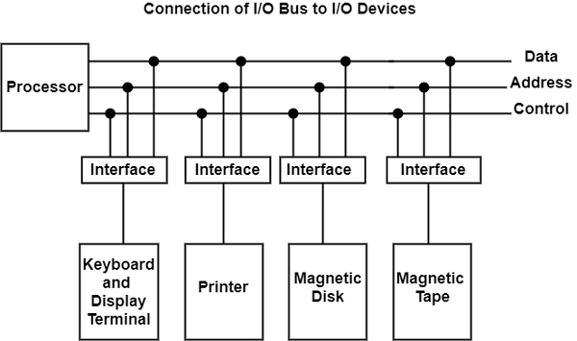
I/O Bus and Interface Modules

Slide 8
An interface receives any of the following four commands −
Control − A command control is given to activate the peripheral and to inform its next task or what to do?
Status − A status command can test multiple test conditions in the interface and the peripheral.
Data Output − sending data from the bus to one of its registers.
Data Input − The data input command is opposite to the data output command. In data input, the interface gets an element of data from the peripheral and places it in its buffer register.

Slide 9
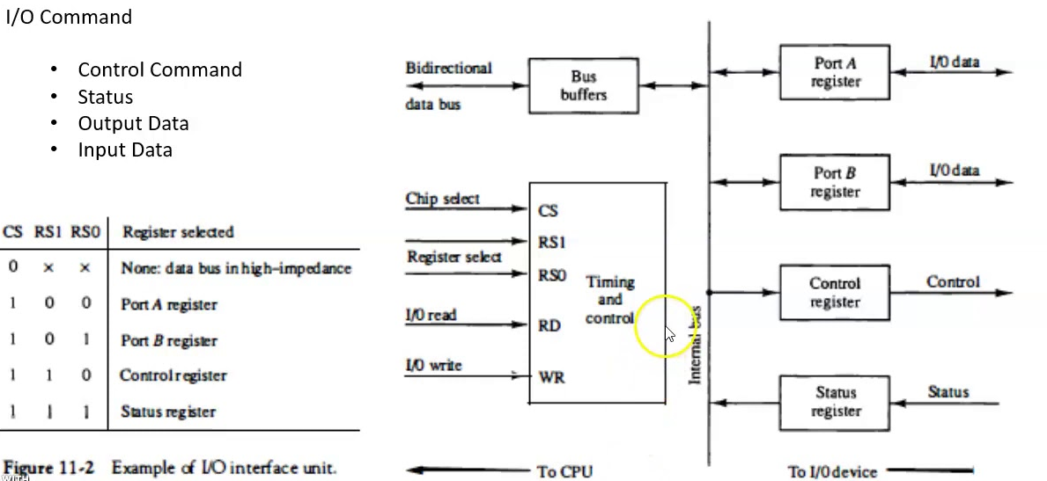

Slide 10
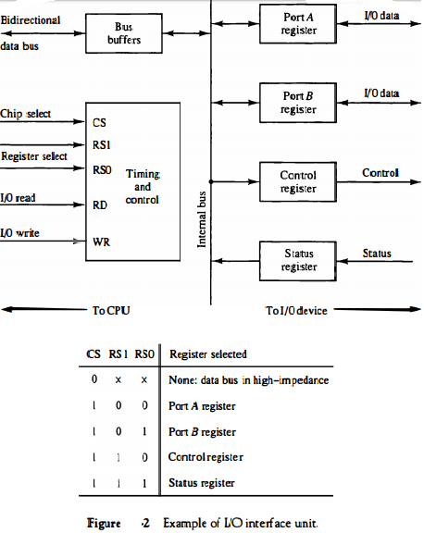

Slide 11
Asynchronous data transfer
Asynchronous data transfer enables computers to send and receive data without having to wait for a real-time response.
With this technique, data is conveyed in discrete units known as packets that may be handled separately

Slide 12
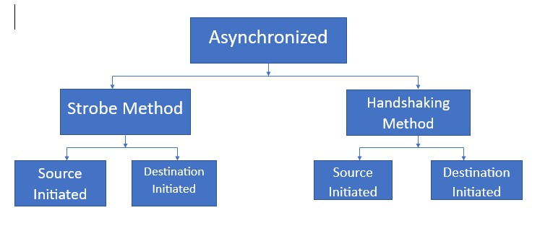

Slide 13
Strobe control: A strobe pulse is supplied by one unit to indicate to the other unit when the transfer has to occur.
Handshaking: This method is commonly used to accompany each data item being transferred with a control signal that indicates data in the bus. The unit receiving the data item responds with another signal to acknowledge receipt of the data.

Slide 14
Strobe Control Method
The Strobe Control method of asynchronous data transfer employs a single control line to time each transfer.
This control line is also known as a strobe, and it may be achieved either by source or destination, depending on which initiate the transfer

Slide 15
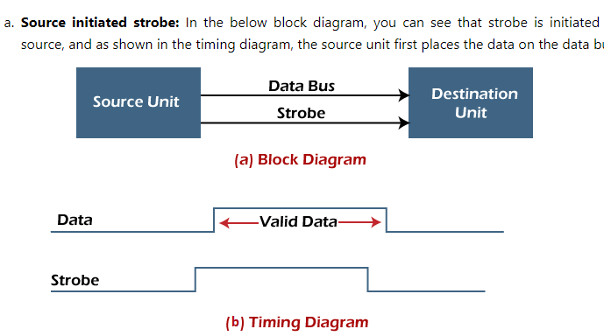

Slide 16
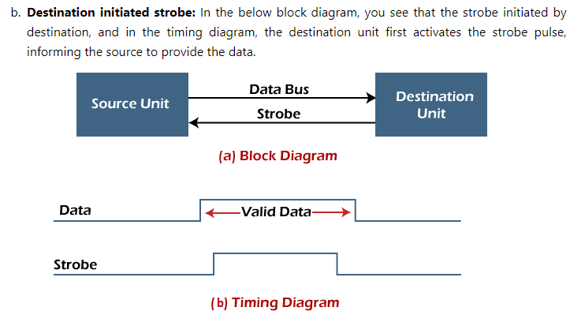

Slide 17
Handshaking Method
The strobe method has the disadvantage that the source unit that initiates the transfer has no way of knowing whether the destination has received the data that was placed in the bus. Similarly, a destination unit that initiates the transfer has no way of knowing whether the source unit has placed data on the bus.
So this problem is solved by the handshaking method. The handshaking method introduces a second control signal line that replays the unit that initiates the transfer.

Slide 18
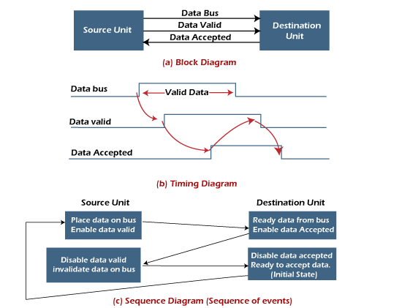
Source initiated handshaking

Slide 19
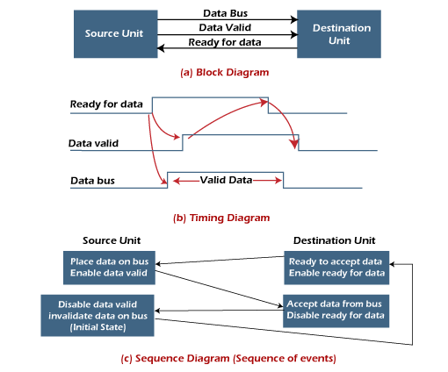
Destination initiated handshaking

Slide 20
MODES OF TRANSFER
The data transfer can be handled by various modes.
some of the modes use CPU as an intermediate path, others transfer the data directly to and from the memory unit and this can be handled by 3 following ways:
i. Programmed I/O
ii. Interrupt-Initiated I/O
iii. Direct Memory Access (DMA)

Slide 21
1. Programmed I/O
Programmed I/O uses the I/O instructions written in the computer program.
The instructions in the program initiate every data item transfer. Usually, the data transfer is from a memory and CPU register.
This case requires constant monitoring by the peripheral device's CPU.

Slide 22
Advantages:
Programmed I/O is simple to implement.
It requires very little hardware support.
CPU checks status bits periodically.
Disadvantages:
The processor has to wait for a long time for the I/O module to be ready for either transmission or reception of data.
The performance of the entire system is severely degraded.

Slide 23
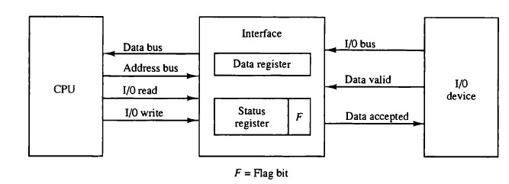
Programmed I/O

Slide 24
Interrupt-initiated I/O
In the above section, we saw that the CPU is kept busy unnecessarily.
We can avoid this situation by using an interrupt-driven method for data transfer.
The interrupt facilities and special commands inform the interface for issuing an interrupt request signal as soon as the data is available from any device.
In the meantime, the CPU can execute other programs, and the interface will keep monitoring the i/O device.
Whenever it determines that the device is ready for transferring data interface initiates an interrupt request signal to the CPU. As soon as the CPU detects an external interrupt signal, it stops the program it was already executing, branches to the service program to process the I/O transfer, and returns to the program it was initially running.

Slide 25
Direct Memory Access (DMA)
The data transfer between any fast storage media like a memory unit and a magnetic disk gets limited with the speed of the CPU.
Thus it will be best to allow the peripherals to directly communicate with the storage using the memory buses by removing the intervention of the CPU.
This mode of transfer of data technique is known as Direct Memory Access (DMA).
During Direct Memory Access, the CPU is idle and has no control over the memory buses.
The DMA controller takes over the buses and directly manages data transfer between the memory unit and I/O devices.

Slide 26
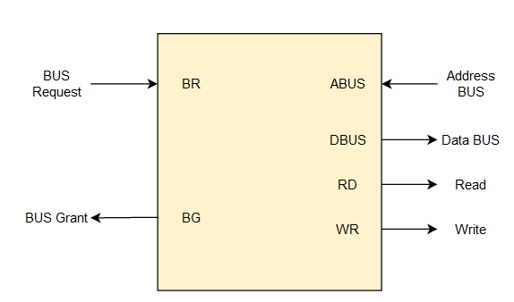

Slide 27
Modes of Data Transfer in DMA
There are 2 modes of data transfer in DMA that are described below.
Burst Mode: In Burst Mode, buses are handed over to the CPU by the DMA if the whole data is completely transferred, not before that.
Cycle Stealing Mode: In Cycle Stealing Mode, buses are handed over to the CPU by the DMA after the transfer of each byte.
Continuous request for bus control is generated by this Data Transfer Mode. It works more easily for higher-priority tasks.

Slide 28
DMA Controller
Direct Memory Access uses hardware for accessing the memory, that hardware is called a DMA Controller.
It has the work of transferring the data between Input Output devices and main memory with very less interaction with the processor.
The direct Memory Access Controller is a control unit, which has the work of transferring data.

Slide 29
Bus Request - We use bus requests in the DMA controller to ask the CPU to relinquish the control buses.
Bus Grant - CPU activates bus grant to inform the DMA controller that DMA can take control of the control buses. Once the control is taken, it can transfer data in many ways.

Slide 30
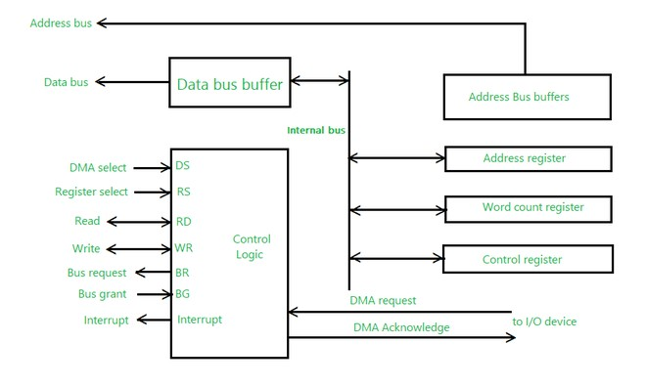
DMA Controller

Slide 31
Address register – It contains the address to specify the desired location in memory.
Word count register – It contains the number of words to be transferred.
Control register – It specifies the transfer mode.

Slide 32
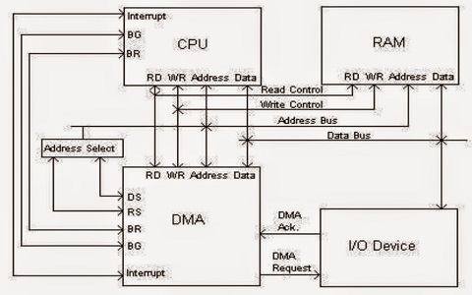
DMA transfer in computer system

Slide 33
Unit-4 Part-II
Memory organization
Memory Hierarchy
Main Memory
Auxiliary Memory
Associative Memory
Cache Memory

